Slide 1
Calibration Methodology
June, 16th 2020

Slide 2
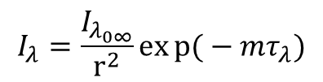
Beer-Lambert-Bourger Law
$$I_{λ}=\frac{I_{λ_{0∞}}}{r^{2}}exp{(}−mτ_{λ})$$

Slide 3
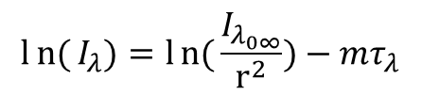
Langley Plot Calibration
$$ln{(}I_{λ})=ln{(}\frac{I_{λ_{0∞}}}{r^{2}})−mτ_{λ}$$

Slide 4
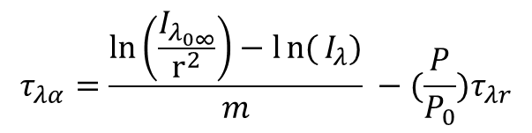
AOD
$$τ_{λα}=\frac{\ln\left(\frac{I_{λ_{0∞}}}{r^{2}}\right)−ln{(}I_{λ})}{m} −(\frac{P}{P_{0}})τ_{λr}$$

Slide 5
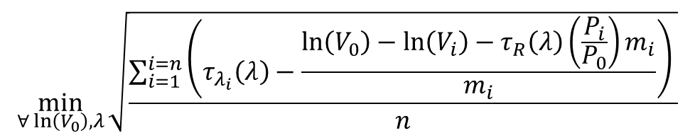
Fitting Parameter Calibration
$$\min_{∀\ln\left(V_{0}\right),λ}{\sqrt{\frac{\sum_{i=1}^{i=n}{\left(τ_{λ_{i}}\left(λ\right)−\frac{\ln\left(V_{0}\right)−\ln\left(V_{i}\right)−τ_{R}\left(λ\right)\left(\frac{P_{i}}{P_{0}}\right)m_{i}}{m_{i}}\right)} }{n}}}$$

Slide 6
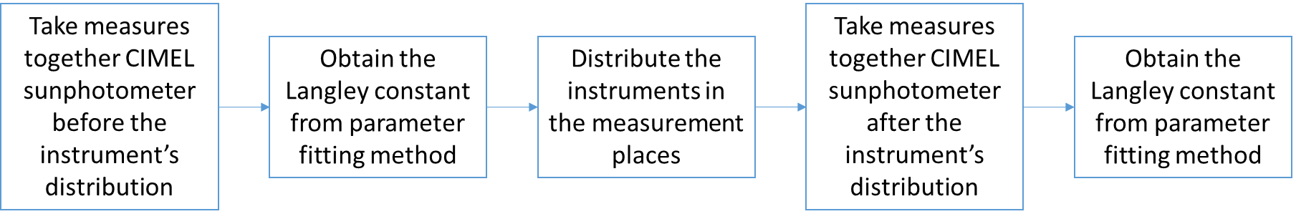
Calibration Methodology

Slide 7
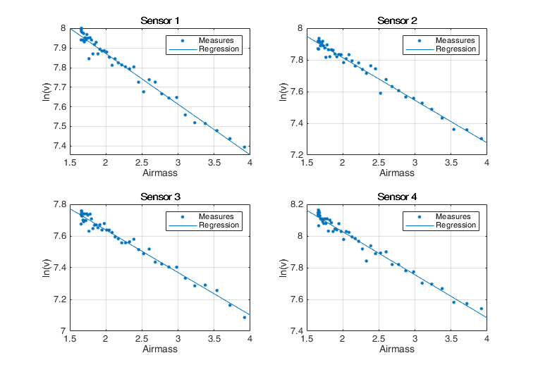
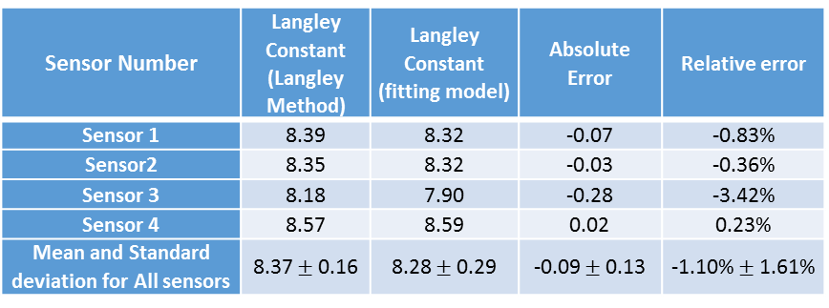
Langley Plot Results
Sensor Number | Langley Constant (Langley Method) | Langley Constant (fitting model) | Absolute Error | Relative error
Sensor 1 | 8.39 | 8.32 | -0.07 | -0.83%
Sensor2 | 8.35 | 8.32 | -0.03 | -0.36%
Sensor 3 | 8.18 | 7.90 | -0.28 | -3.42%
Sensor 4 | 8.57 | 8.59 | 0.02 | 0.23%
Mean and Standard deviation for All sensors | 8.37 $±$ 0.16 | 8.28 $±$ 0.29 | -0.09 $±$ 0.13 | -1.10% $±$ 1.61%

Slide 8
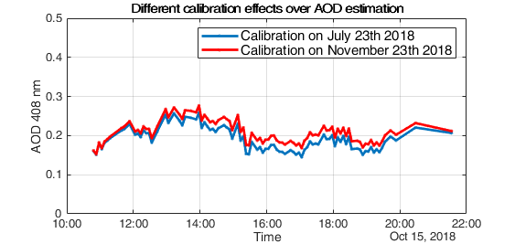
Comparison of AOD for the same measurements under 2 calibration days with 4 months of difference

Slide 9
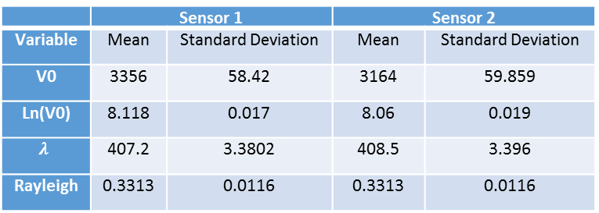
Stochastic Approach for Calibration
 | Sensor 1 |  | Sensor 2
Variable | Mean | Standard Deviation | Mean | Standard Deviation
V0 | 3356 | 58.42 | 3164 | 59.859
Ln(V0) | 8.118 | 0.017 | 8.06 | 0.019
$$λ$$ | 407.2 | 3.3802 | 408.5 | 3.396
Rayleigh | 0.3313 | 0.0116 | 0.3313 | 0.0116

